Slide 1
PSCS_35_360-degree feedback software for the Government of India related News Stories in Regional Media using Artificial Intelligence / Machine Learning
CSE7101- Capstone Project
Review-5
Batch Number:IST_32
Under the Supervision of,
Ms.Sunitha B.J
Professor at
School of Computer Science and Engineering
Presidency University
Roll Number | Student Name
20221IST0022 | Kiran Gowda S
20221IST0049 | Rahul S Gowda
Name of the Program: Information Science and Technology
Name of the HoD: Dr. Pallavi R
Name of the Program Project Coordinator: Ms. Benitha Christinal J
Name of the School Project Coordinators: Dr. Sampath A K , Dr. Geetha A

Slide 2
Content
Problem Statement
Literature Survey
Objectives
Proposed Method & Feasibility Study
Architecture Diagram
Modules and Technologies Used
Hardware and Software Details
Timeline of the Project
References

Slide 3
Problem Statement Number: PSCS_582
Problem Statement Number: PSCS_35
Organization: Presidency University
Category: Software
Problem Description: The current manual process of monitoring regional media by PIB is slow, error-prone, and lacks real-time insights. Categorization of stories across 22+ Indian languages is inefficient, and negative news often goes unnoticed. There is a need for an AI/ML-based automated system to crawl news sites and YouTube, apply OCR on e-papers, classify stories by department and sentiment, and instantly notify concerned officers, ensuring timely and accurate feedback to the Government of India..

Slide 4
Literature Survey
Exploring Multilingual Indian Twitter Sentiment Analysis (IEEE, 2023).
Sentiment Analysis of Indian Languages using CNNs (IEEE, 2018).
CNN + RNN for Hindi Tweets (IEEE, 2019).
Comprehensive Review of Sentiment Analysis on Indian Regional Languages (IEEE, 2023).
Recent Advances in Sentiment Analysis of Indian Languages (2020).
Stopwords Aware Emotion-Based Sentiment Analysis of News Articles (2023).
Machine Learning-Based Sentiment Analysis Towards Indian Ministry (2022).
Siamese Networks for Low-Resource Languages (2018).
DravidianCodeMix Dataset for Sentiment Analysis (2021).
L3Cube-IndicNews Dataset (2024).
These studies provide insights into multilingual sentiment analysis, handling of regional and low-resource languages, and government-related news categorization. Collectively, they guide our methodology in developing a comprehensive feedback system.

Slide 5
Objectives and Existing Methods and Drawbacks
- To develop a multilingual news monitoring system for regional media.
- To implement AI/ML techniques for sentiment analysis in Indian languages.
- To classify government-related news into ministries and departments.
- To design an alert mechanism for negative coverage.
- To provide a real-time dashboard for feedback analysis.
Existing Methods and Drawbacks
Existing systems for media monitoring are often limited to English-language sources, lack comprehensive multilingual support, and fail to integrate sentiment analysis at the granularity of Indian government ministries. Many current tools provide only keyword-based search without contextual sentiment understanding, resulting in low accuracy and delayed feedback.

Slide 6
Proposed Method & Feasibility Study
The proposed system integrates:
1. Web Crawling (BeautifulSoup, Selenium) to gather news from digital platforms.
2. NLP Pipelines using BERT/IndicBERT for multilingual sentiment analysis.
3. Categorization models to map news items to ministries.
4. Alert system via email for negative sentiment detection.
5. Dashboard (Next.js, Tailwind, Django backend) for visualization.
Feasibility: Open-source libraries and cloud deployment make the solution cost-effective. Indian language models (IndicNLP, L3Cube datasets) are publicly available, ensuring practical implementation

Slide 7
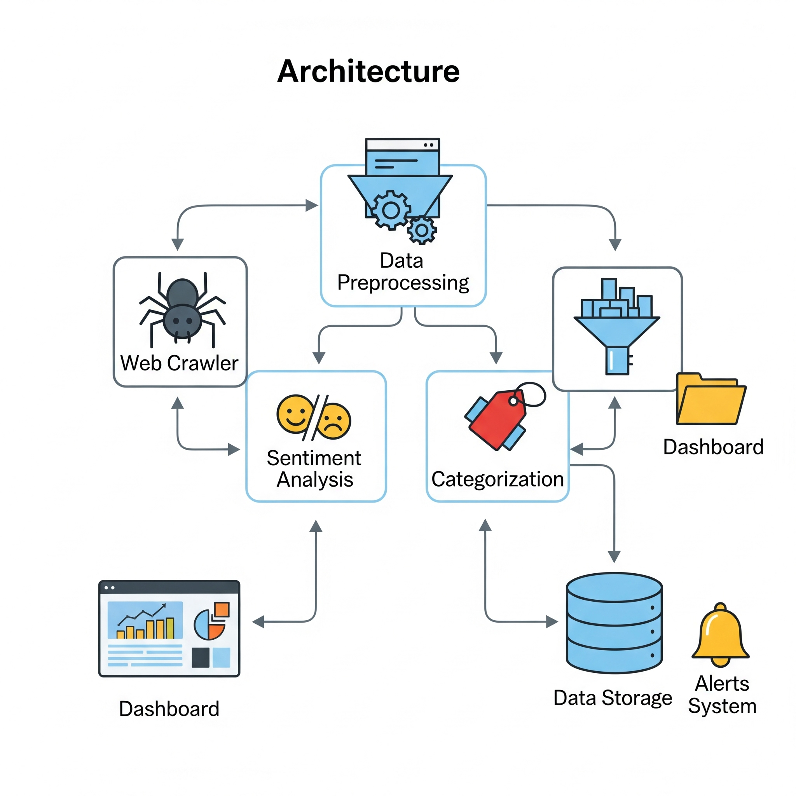
Architecture Diagram
Web Crawling → Preprocessing → Sentiment Analysis → Categorization → Dashboard & Alerts

Slide 8
Modules and Technologies Used
1. Data Collection Module – Web crawling and scraping.
2. Preprocessing Module – Language detection, tokenization, stopword removal.
3. Sentiment Analysis Module – Deep learning/NLP models.
4. Categorization Module – Mapping news to ministries.
5. Alert Module – Negative news notification system.
6. Dashboard Module – Visualization and reporting.
Technologies Used
- Programming: Python, JavaScript
- Frameworks: Django, Next.js, Tailwind CSS
- Libraries: TensorFlow, PyTorch, Hugging Face Transformers, BeautifulSoup, Selenium
- Database: PostgreSQL/MySQL
- Tools: Power BI for analytics visualization
- Deployment: Docker, Cloud hosting (AWS/Azure)

Slide 9
Hardware and Software Details
Hardware:
- Minimum 8 GB RAM, Quad-core CPU, GPU-enabled system for model training.
Software:
- Operating System: Windows/Linux
- Development Tools: VS Code, Jupyter Notebook
- Libraries: TensorFlow, PyTorch, NLTK, SpaCy
- Browser Automation: Selenium

Slide 10
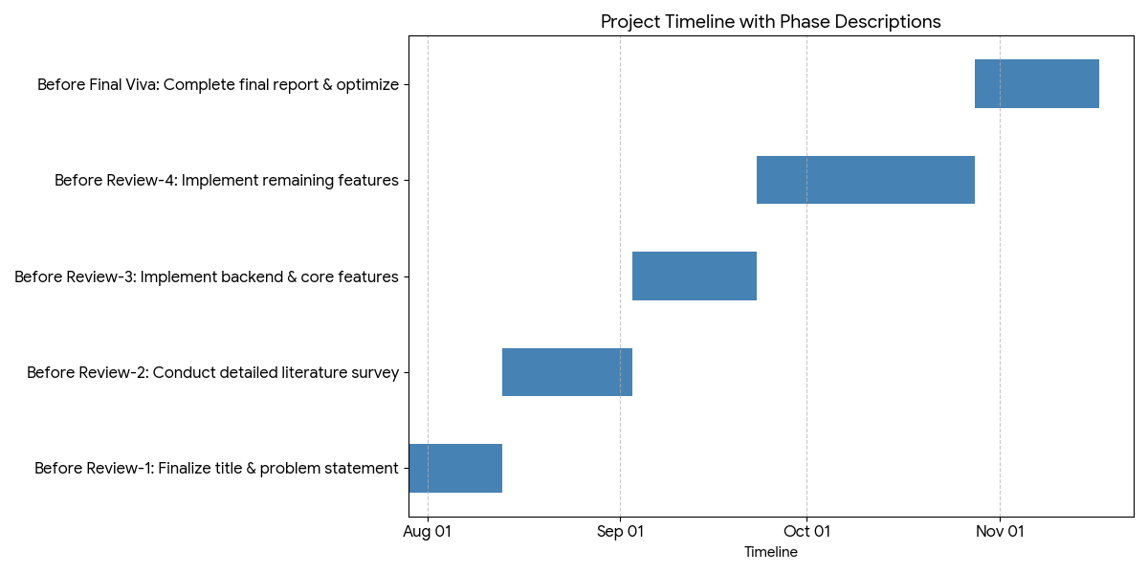
Timeline of the Project (Gantt Chart)

Slide 11
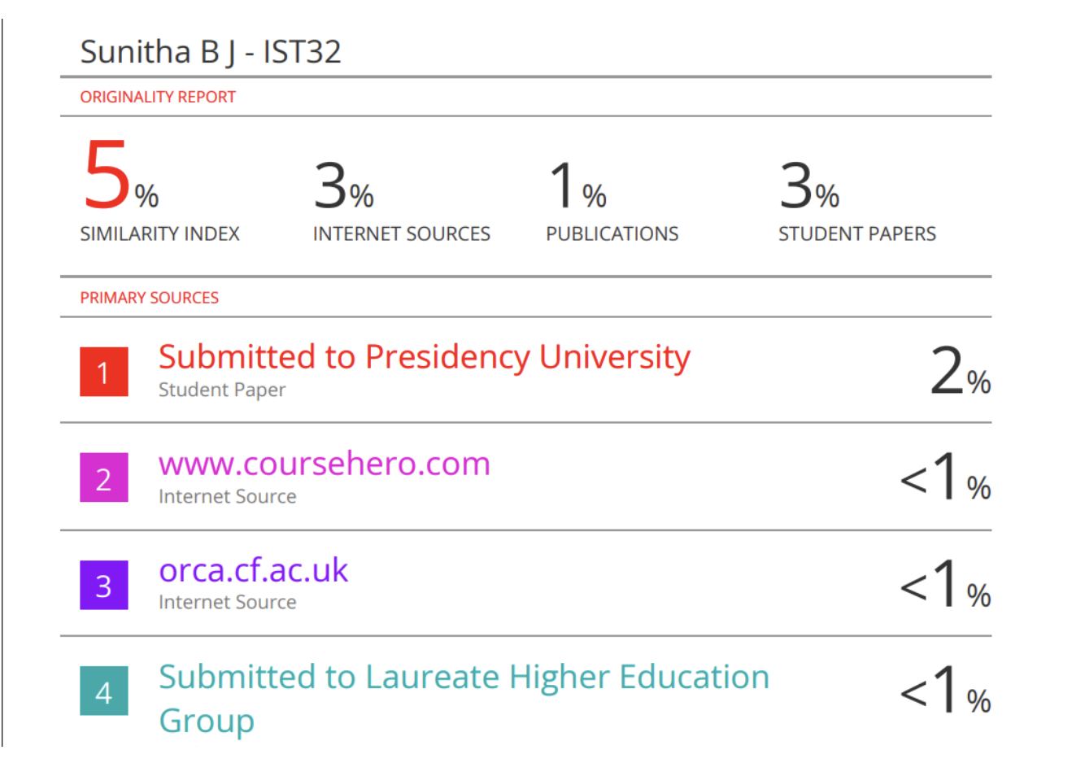
Plagiarism Report

Slide 12
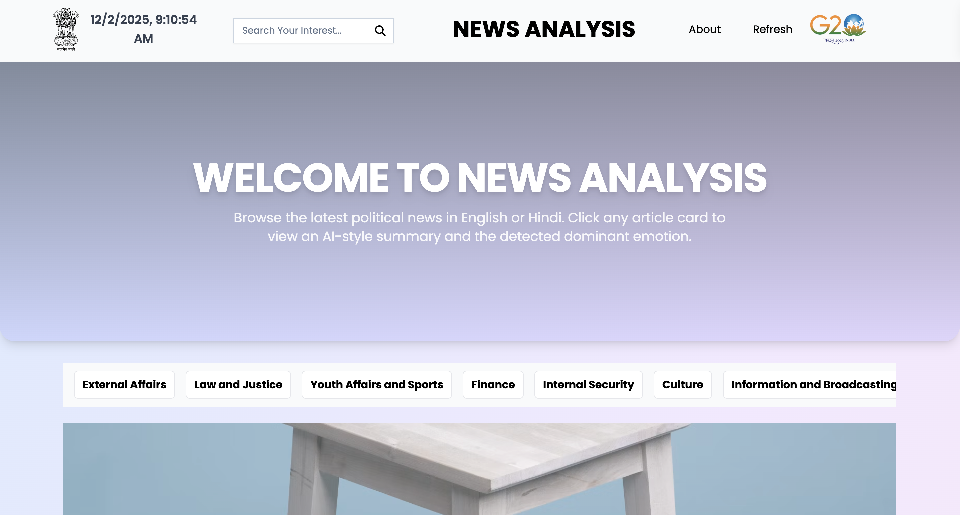
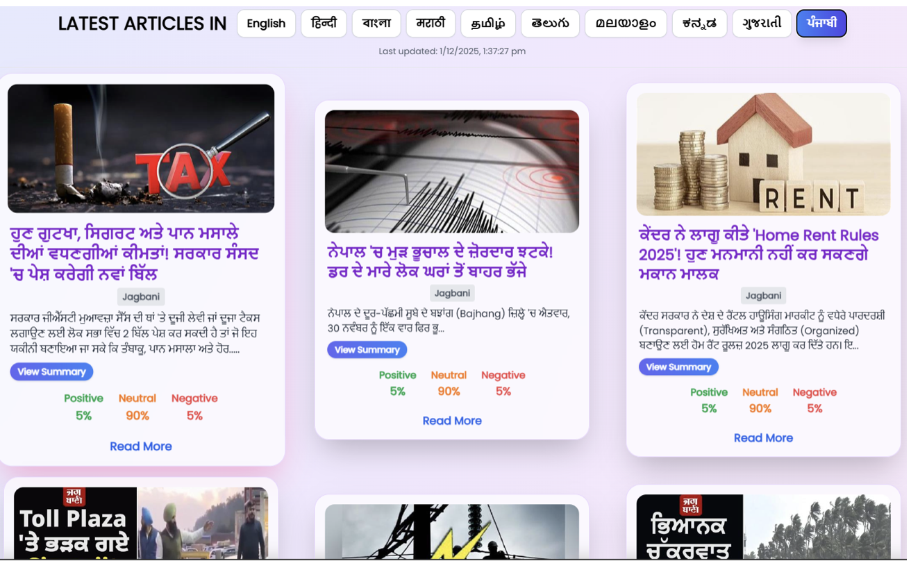
Project Dashboard

Slide 13
References (IEEE Paper format)
1. IEEE Paper: Exploring Multilingual Indian Twitter Sentiment Analysis.
2. IEEE Paper: Sentiment Analysis of Indian Languages using CNNs.
3. IEEE Paper: CNN + RNN for Hindi Tweets.
4. IEEE Paper: Comprehensive Review of Sentiment Analysis on Indian Regional Languages.
5. IEEE Paper: Recent Advances in Sentiment Analysis of Indian Languages.
6. IEEE Paper: Stopwords Aware Emotion-Based Sentiment Analysis of News Articles.
7. IEEE Paper: Machine Learning-Based Sentiment Analysis Towards Indian Ministry.
8. IEEE Paper: Siamese Networks for Low-Resource Languages.
9. IEEE Paper: DravidianCodeMix Dataset for Sentiment Analysis.
10. IEEE Paper: L3Cube-IndicNews Dataset.

Slide 14


